Slide 1
Embedded Systems
NXP
University Course

Slide 2
Course Contents
General topics, Courses & Labs
General Presentation of the Course
V-Model, Requirements Engineering, Process | Understand and Create Requirements
Process | Git, IDE Setup, Compile and Flash the Hello World Project
Architecture (UML) | Virtual Machine Environment Setup
How Hardware and Software are Linked | From Compiling to Electrical Signals and Debugging
RGB | Hands-on Lab (no module – just the dev board)
Node 1: Brake
Node 2: Lights
Review and Exercises

Slide 3

Exercise: RED-YELLOW-BLUE

Slide 4
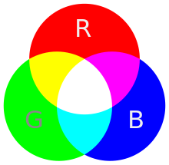
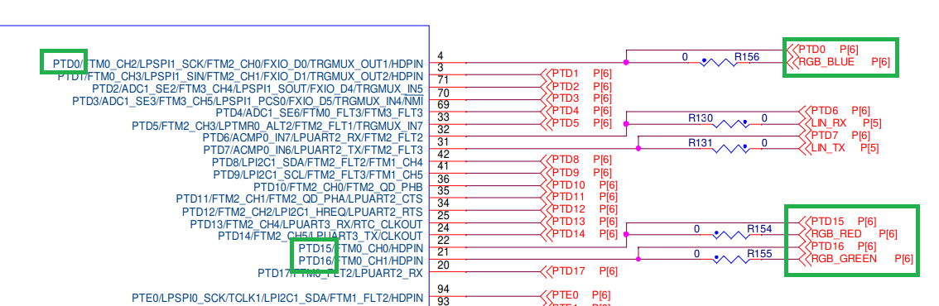
The initial demo project will make the RGB LED to blink rapidly RED and GREEN colors
Scope of this exercise is to make the RGB LED to blink on RED, YELLOW and BLUE
RGB_BLUE – PTD0 ; RGB_RED – PTD15 ; RGB_GREEN – PTD16
Board pinout

Slide 5
Exercise: RED-YELLOW-BLUE
Before
Target result

Slide 6
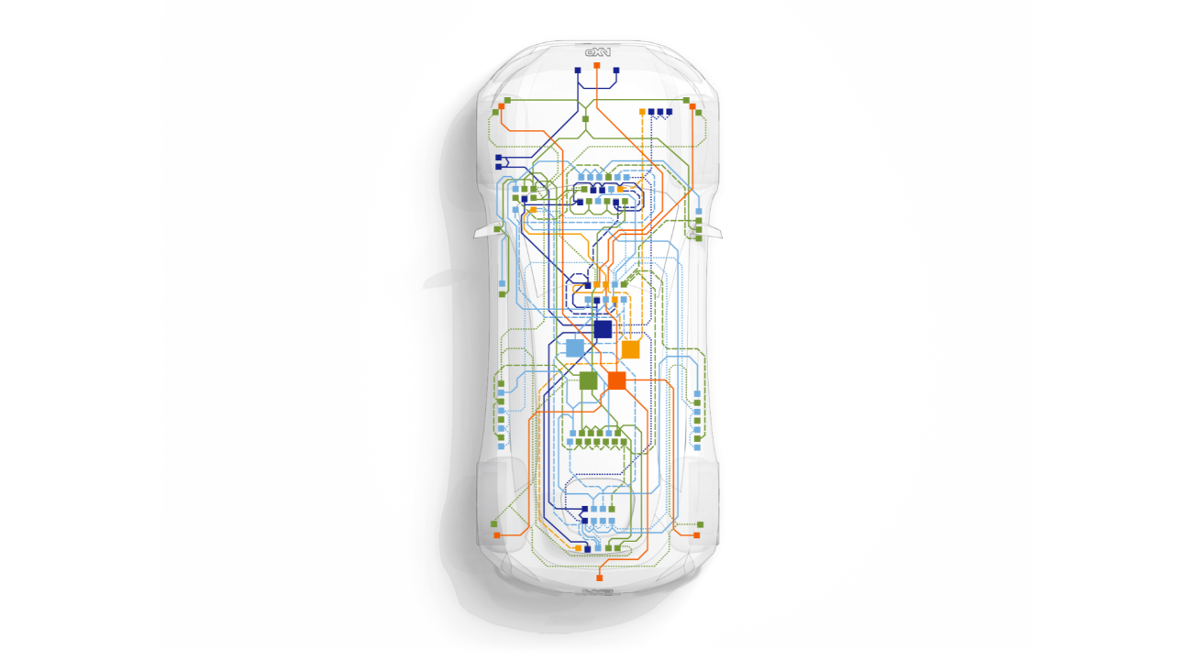


REPLI-CAR NETWORK
Lights CONTROL node
Replicate Body Control Module behavior
· Actuate lights (headlamps, turn indicators), horn and washer pump based on input controller from HMI
· Communications with other nodes: HMI, PCM, Brake, Steering, Comfort
LIGHTS
brake control node
Replicate Brake Control Module behavior
· brake actuation and brake lamp indication based on input controller from HMI
· Communications with other nodes: HMI, PCM, BCM
brake

Slide 7
Brake
04

Slide 8
Exercise: BRAKE

Slide 9
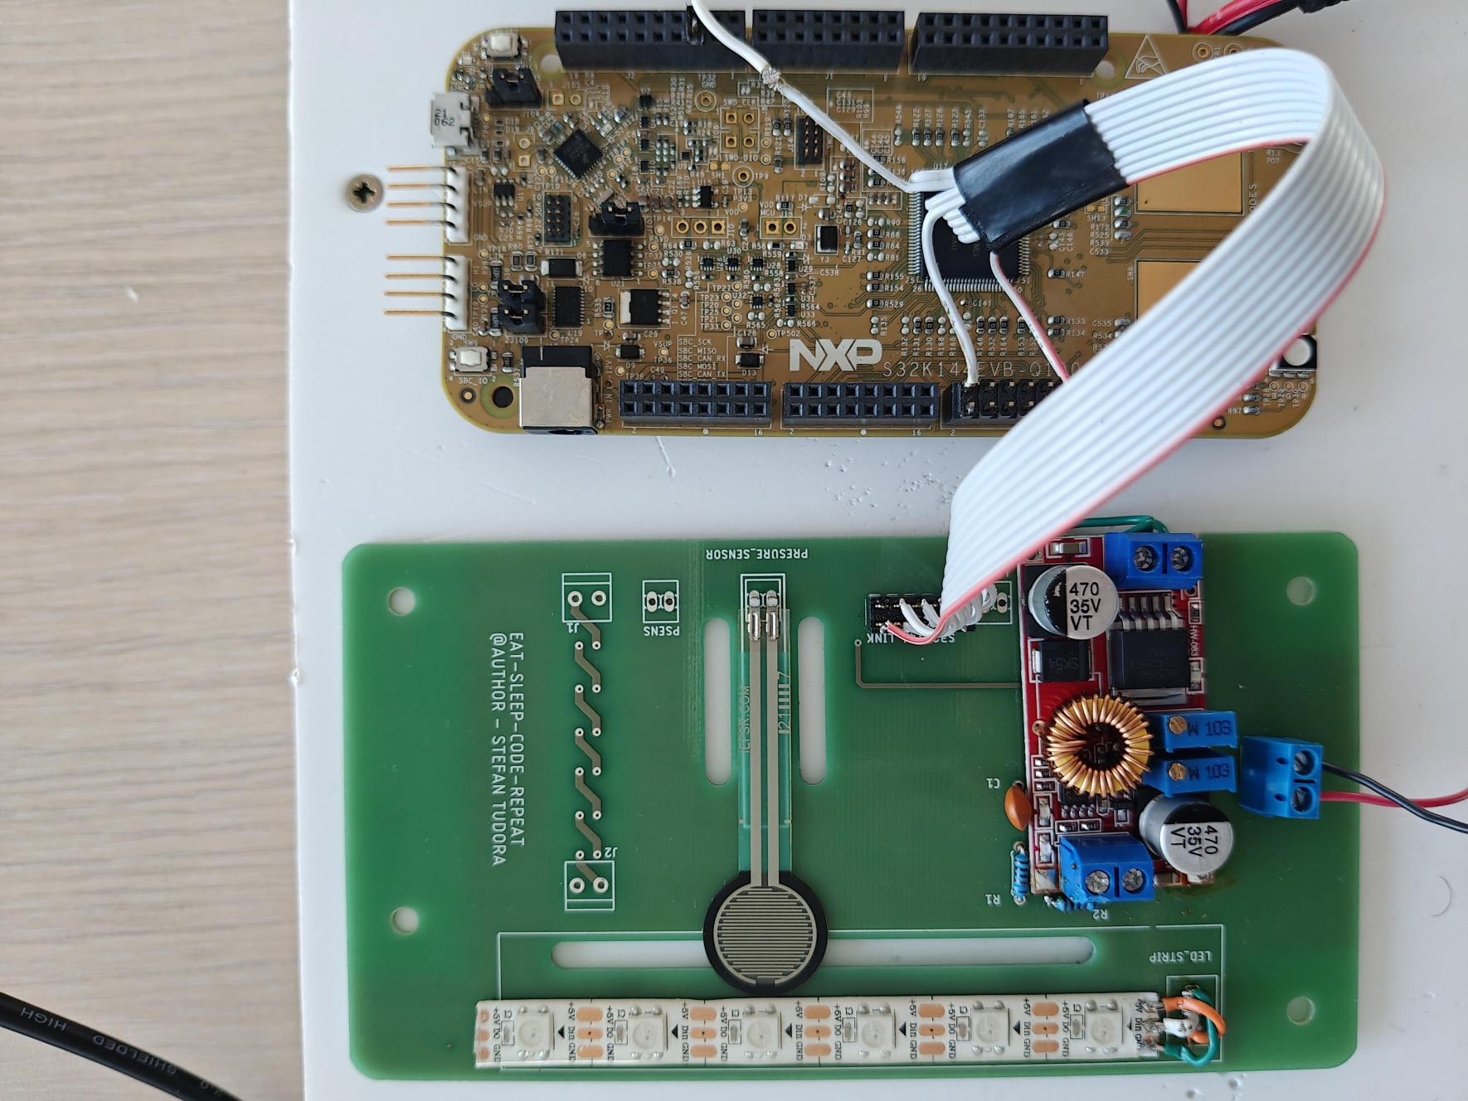
BRAKE

Slide 10
BAND WITH 8 LEDS
PTE 16
PINS
PINS
15K
15K
C
HW-083
PRESSURE SENSOR
12V
GND

Slide 11
Lights (LCN)
01

Slide 12
Exercise: LIGHTS

Slide 13
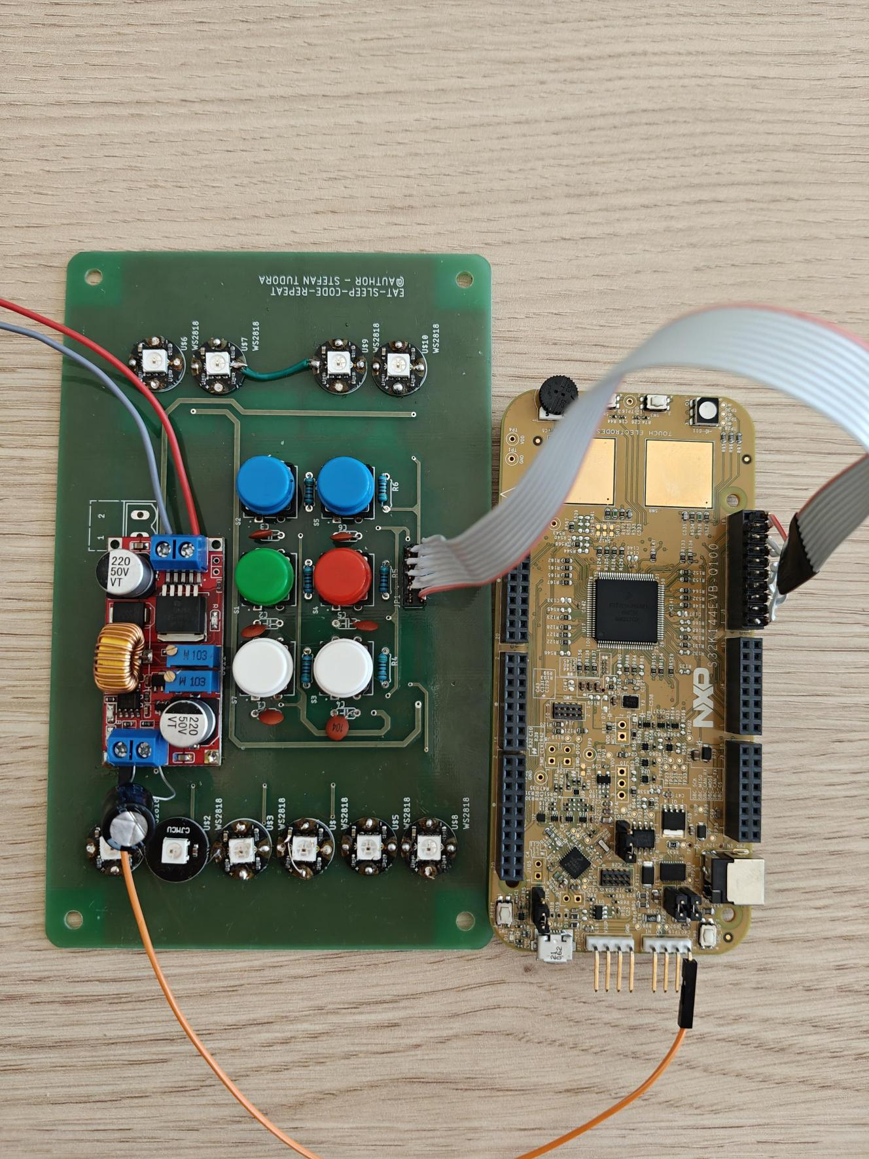
LIGHTS

Slide 14
AC
VCC
AC
GND
5.6k
5.6k
5.6k
5.6k
5.6k
5.6k
Firul verde trece prin legatura
Condensator-Buton
Firul galben trece prin rezistente

Slide 15
NC
PTE1
PTE14
PTE16
GND
K144 PINS
PTD6
PTD7
PTE13
PTE15
NC

Slide 16
FINAL SETUP
04

Slide 17
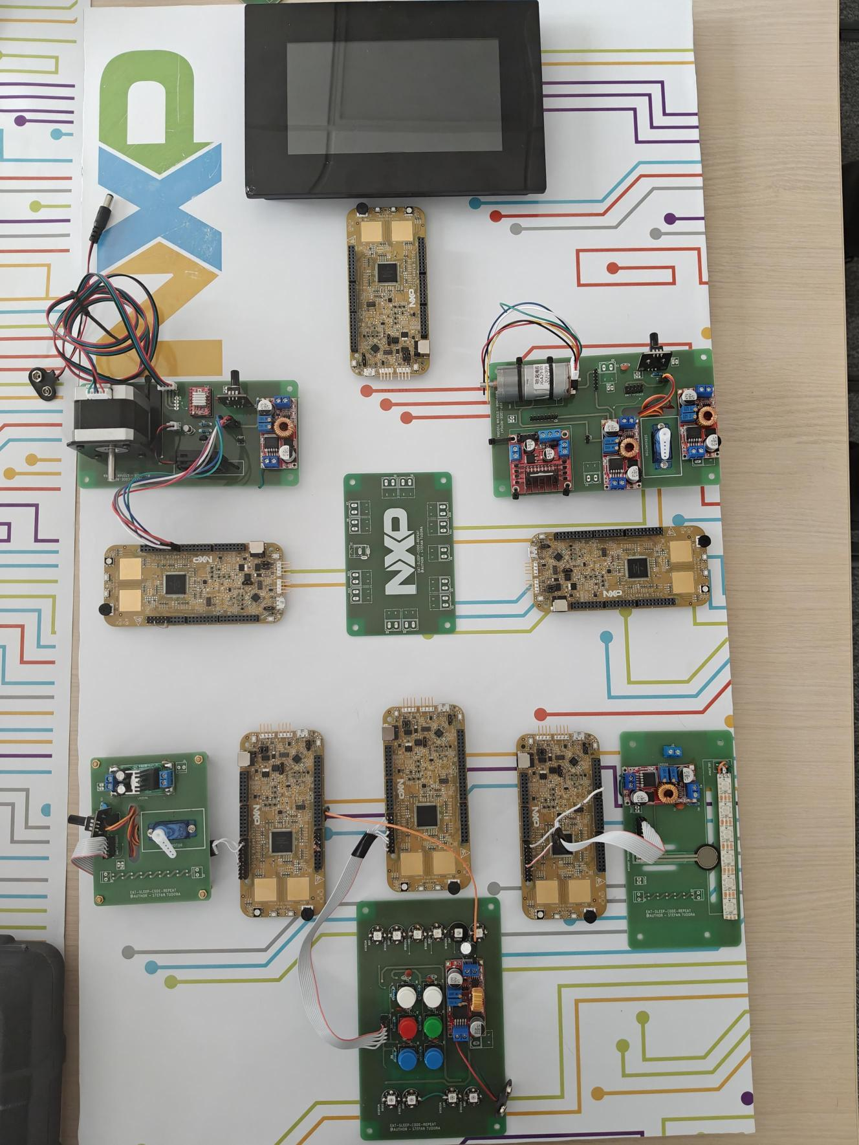
FINAL SETUP

Slide 18
